Slide 1
Sequence Diagrams | Unified Modeling Language (UML)
Unified Modelling Language (UML) is a modeling language in the field of software engineering that aims to set standard ways to visualize the design of a system. UML guides the creation of multiple types of diagrams such as interaction, structure, and behavior diagrams. A sequence diagram is the most commonly used interaction diagram.
Interaction diagram
An interaction diagram is used to show the interactive behavior of a system. Since visualizing the interactions in a system can be difficult, we use different types of interaction diagrams to capture various features and aspects of interaction in a system.
A sequence diagram simply depicts the interaction between the objects in a sequential order i.e. the order in which these interactions occur.
We can also use the terms event diagrams or event scenarios to refer to a sequence diagram.
Sequence diagrams describe how and in what order the objects in a system function.
These diagrams are widely used by businessmen and software developers to document and understand requirements for new and existing systems.

Slide 2
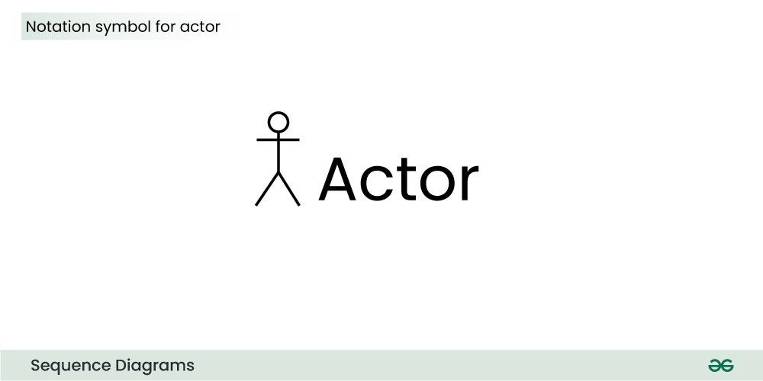
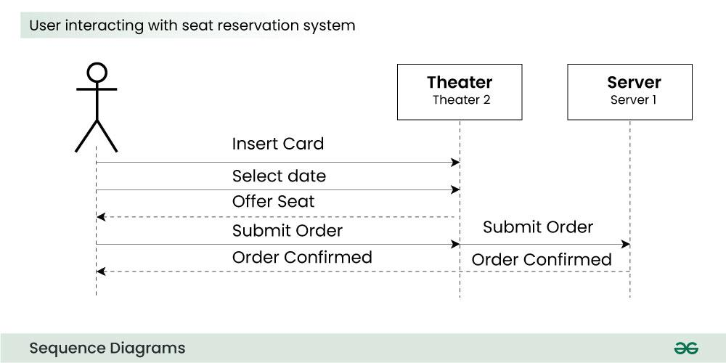
1. Sequence Diagram Notation
1.1. Actors
An actor in a UML diagram represents a type of role where it interacts with the system and its objects. It is important to note here that an actor is always outside the scope of the system we aim to model using the UML diagram.
Actor
We use actors to depict various roles including human users and other external subjects. We represent an actor in a UML diagram using a stick person notation. We can have multiple actors in a sequence diagram.
For example:
Here the user in seat reservation system is shown as an actor where it exists outside the system and is not a part of the system.

Slide 3
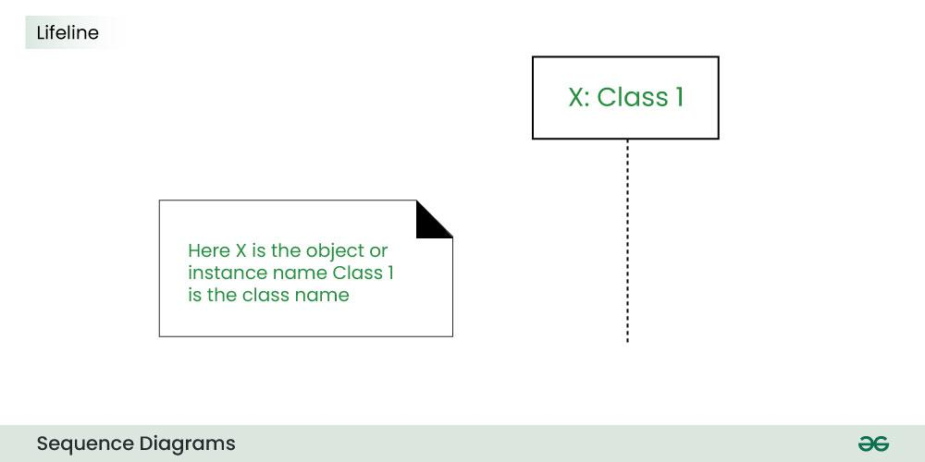
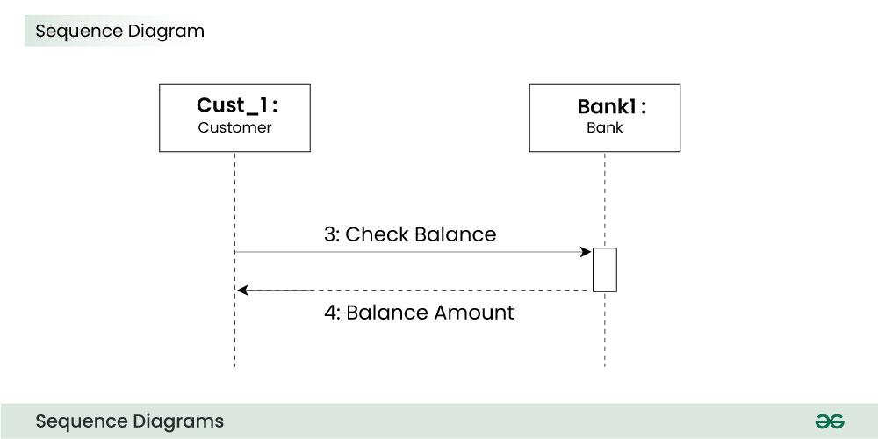
1.2. Lifelines
A lifeline is a named element which depicts an individual participant in a sequence diagram. So basically each instance in a sequence diagram is represented by a lifeline. Lifeline elements are located at the top in a sequence diagram. The standard in UML for naming a lifeline follows the following format:
Instance Name : Class Name
We display a lifeline in a rectangle called head with its name and type. The head is located on top of a vertical dashed line (referred to as the stem) as shown above.
If we want to model an unnamed instance, we follow the same pattern except now the portion of lifeline’s name is left blank.
Difference between a lifeline and an actor
A lifeline always portrays an object internal to the system whereas actors are used to depict objects external to the system.
The following is an example of a sequence diagram:

Slide 4
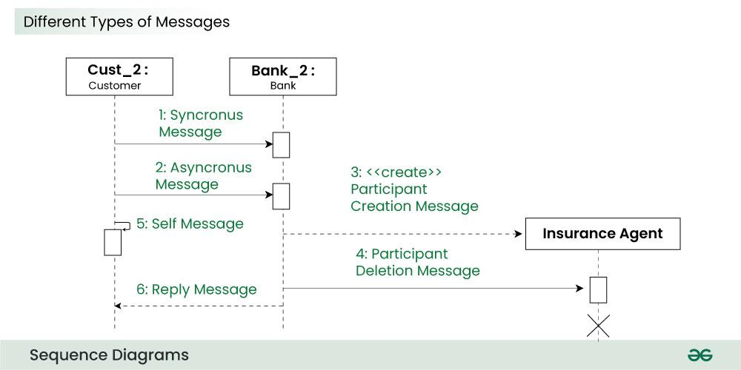
1.3. Messages
Communication between objects is depicted using messages. The messages appear in a sequential order on the lifeline.
We represent messages using arrows.
Lifelines and messages form the core of a sequence diagram.
Messages can be broadly classified into the following categories:
Synchronous messages
A synchronous message waits for a reply before the interaction can move forward. The sender waits until the receiver has completed the processing of the message. The caller continues only when it knows that the receiver has processed the previous message i.e. it receives a reply message.
A large number of calls in object oriented programming are synchronous.
We use a solid arrow head to represent a synchronous message.

Slide 5
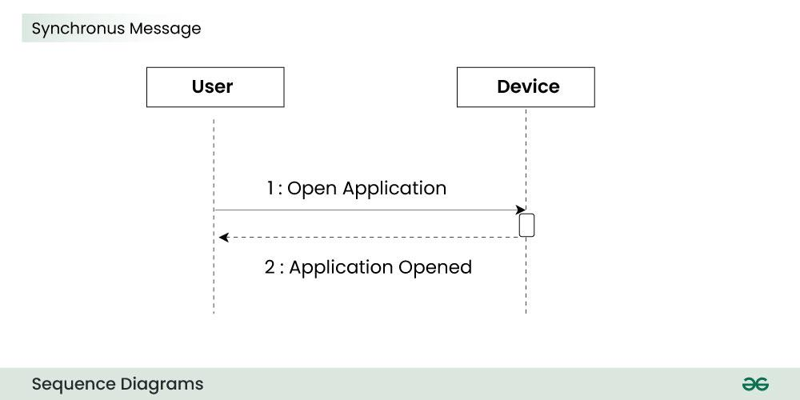
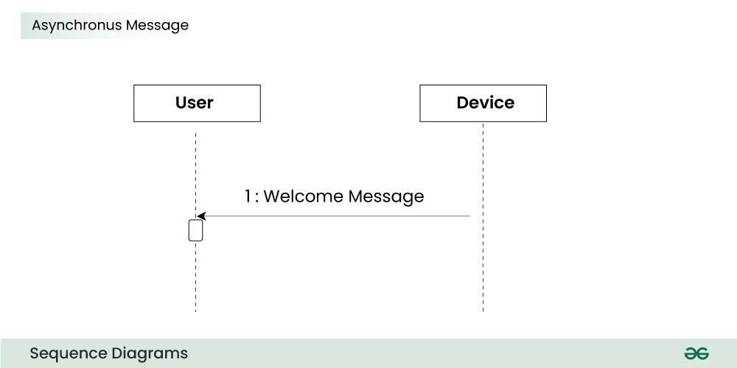
Asynchronous Messages
An asynchronous message does not wait for a reply from the receiver. The interaction moves forward irrespective of the receiver processing the previous message or not. We use a lined arrow head to represent an asynchronous message.

Slide 6
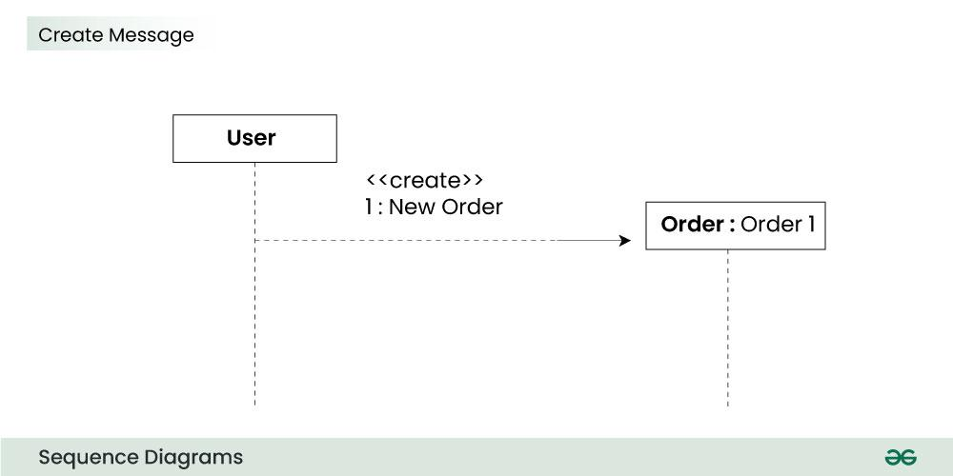
1.4. Create message
We use a Create message to instantiate a new object in the sequence diagram. There are situations when a particular message call requires the creation of an object. It is represented with a dotted arrow and create word labelled on it to specify that it is the create Message symbol.
For example:
The creation of a new order on a e-commerce website would require a new object of Order class to be created.

Slide 7
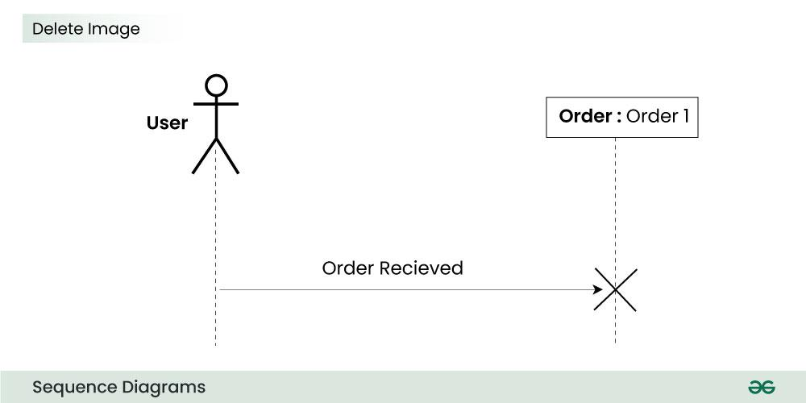
1.5. Delete Message
We use a Delete Message to delete an object. When an object is deallocated memory or is destroyed within the system we use the Delete Message symbol. It destroys the occurrence of the object in the system.It is represented by an arrow terminating with a x.
In the scenario below when the order is received by the user, the object of order class can be destroyed.

Slide 8
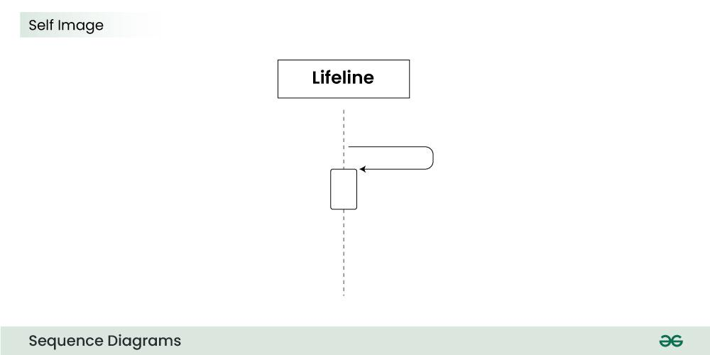
1.6. Self Message
Certain scenarios might arise where the object needs to send a message to itself. Such messages are called Self Messages and are represented with a U shaped arrow.

Slide 9
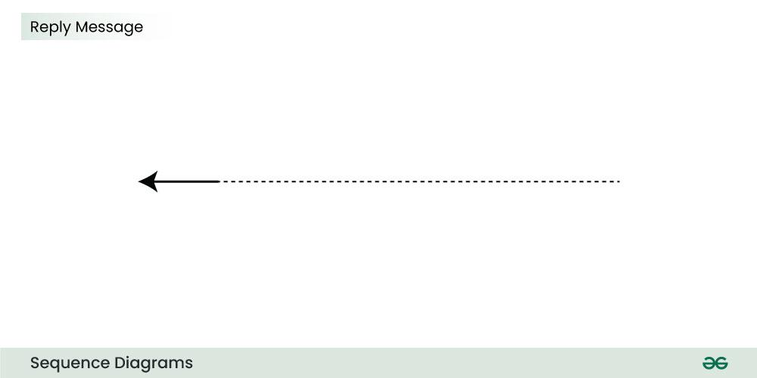
1.7. Reply Message
Reply messages are used to show the message being sent from the receiver to the sender. We represent a return/reply message using an open arrow head with a dotted line. The interaction moves forward only when a reply message is sent by the receiver.

Slide 10
2. How to create Sequence Diagrams?
Creating a sequence diagram involves several steps, and it’s typically done during the design phase of software development to illustrate how different components or objects interact over time. Here’s a step-by-step guide on how to create sequence diagrams:
Identify the Scenario:
Understand the specific scenario or use case that you want to represent in the sequence diagram. This could be a specific interaction between objects or the flow of messages in a particular process.
List the Participants:
Identify the participants (objects or actors) involved in the scenario. Participants can be users, systems, or external entities.
Define Lifelines:
Draw a vertical dashed line for each participant, representing the lifeline of each object over time. The lifeline represents the existence of an object during the interaction.
Arrange Lifelines:
Position the lifelines horizontally in the order of their involvement in the interaction. This helps in visualizing the flow of messages between participants.

Slide 11
Add Activation Bars:
For each message, draw an activation bar on the lifeline of the sending participant. The activation bar represents the duration of time during which the participant is actively processing the message.
Draw Messages:
Use arrows to represent messages between participants. Messages flow horizontally between lifelines, indicating the communication between objects. Different types of messages include synchronous (solid arrow), asynchronous (dashed arrow), and self-messages.
Include Return Messages:
If a participant sends a response message, draw a dashed arrow returning to the original sender to represent the return message.
Indicate Timing and Order:
Use numbers to indicate the order of messages in the sequence. You can also use vertical dashed lines to represent occurrences of events or the passage of time.
Include Conditions and Loops:
Use combined fragments to represent conditions (like if statements) and loops in the interaction. This adds complexity to the sequence diagram and helps in detailing the control flow.
Consider Parallel Execution:
If there are parallel activities happening, represent them by drawing parallel vertical dashed lines and placing the messages accordingly.

Slide 12
Review and Refine:
Review the sequence diagram for clarity and correctness. Ensure that it accurately represents the intended interaction. Refine as needed.
Add Annotations and Comments:
Include any additional information, annotations, or comments that provide context or clarification for elements in the diagram.
Document Assumptions and Constraints:
If there are any assumptions or constraints related to the interaction, document them alongside the diagram.
Tools:
Use a UML modeling tool or diagramming software to create a neat and professional-looking sequence diagram. These tools often provide features for easy editing, collaboration, and documentation.

Slide 13
What is the Collaboration Diagram?
Collaboration Diagram depicts the relationships and interactions among software objects. They are used to understand the object architecture within a system rather than the flow of a message as in a sequence diagram. They are also known as “Communication Diagrams.”
As per Object-Oriented Programming (OOPs), an object entity has various attributes associated with it. Usually, there are multiple objects present inside an object-oriented system where each object can be associated with any other object inside the system. Collaboration Diagrams are used to explore the architecture of objects inside the system. The message flow between the objects can be represented using a collaboration diagram.
Benefits of Collaboration Diagram
It is also called as a communication diagram.
It emphasizes the structural aspects of an interaction diagram – how lifeline connects.
Its syntax is similar to that of sequence diagram except that lifeline don’t have tails.
Messages passed over sequencing is indicated by numbering each message hierarchically.
Compared to the sequence diagram communication diagram is semantically weak.
Object diagrams are special case of communication diagram.
It allows you to focus on the elements rather than focusing on the message flow as described in the sequence diagram.
Sequence diagrams can be easily converted into a collaboration diagram as collaboration diagrams are not very expressive.
While modeling collaboration diagrams w.r.t sequence diagrams, some information may be lost.

Slide 14
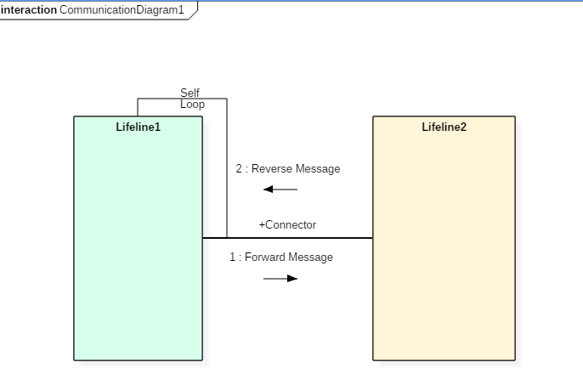

Slide 15
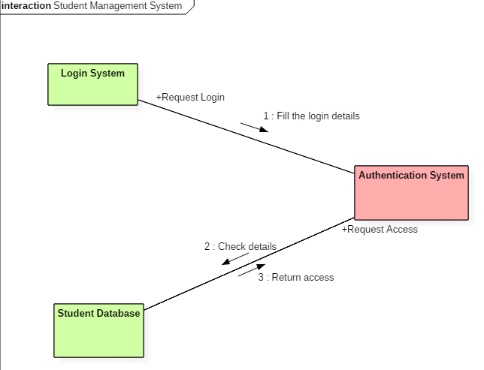
The above collaboration diagram notation contains lifelines along with connectors, self-loops, forward, and reverse messages used in a collaboration diagram.
Drawbacks of a Collaboration Diagram
Collaboration diagrams can become complex when too many objects are present within the system.
It is hard to explore each object inside the system.
Collaboration diagrams are time consuming.
The object is destroyed after the termination of a program.
The state of an object changes momentarily, which makes it difficult to keep track of every single change the occurs within an object of a system.
Collaboration diagram Example
Following diagram represents the sequencing over student management system:

Slide 16
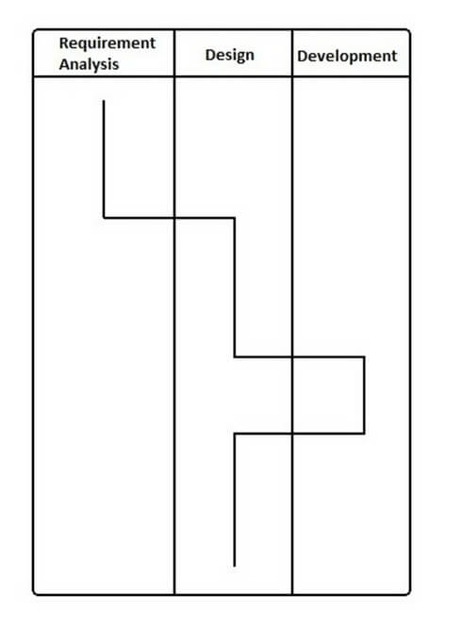
What is Timing Diagram?
Timing Diagram is a waveform or a graph that is used to describe the state of a lifeline at any instance of time. It is used to denote the transformation of an object from one form into another form. Timing diagram does not contain notations as required in the sequence and collaboration diagram. The flow between the software program at various instances of time is represented using a waveform.
Timing diagram Example
The timing diagram given below represents a few phases of a software development life cycle.

Slide 17
How to draw a Interaction diagram?
Interaction diagrams are used to represent the interactive behavior of a system. Interaction diagrams focus on the dynamic behavior of a system. An interaction diagram provides us the context of an interaction between one or more lifelines in the system.
To draw an interaction diagram, you have first to determine the scenario for which you have to draw an interaction diagram. After deciding the situation, identify various lifelines that are going to be involved in the interaction. Categorize all the lifeline elements and explore them to identify possible connections and how the lifelines are related to one another. To draw an interaction diagram, the following things are required:
The total number of lifelines that are going to be part of an interaction
is a sequence of message flow within various objects of a system.
Various operators to ease the functionality of an interaction diagram.
Various types of messages to display the interaction more clearly and in a precise manner.
The ordered sequence of messages.
Organization and a structure of an object.
Various time constructs of an object.

Slide 18
Use of an interaction diagram
Interaction diagrams consist of a sequence diagram, collaboration diagram, and timing diagrams. Following is the specific purpose of an interaction diagram:
Sequence diagrams are used to explore any real application or a system.
Interaction diagrams are used to explore and compare the use of sequence, collaborations, and timing diagrams.
Interaction diagrams are used to capture the behavior of a system. It displays the dynamic structure of a system.
Sequence diagrams are used to represent message flow from one object to another object.
Collaboration diagrams are used to understand the object architecture of a system rather than message flow.
Interaction diagrams are used to model a system as a time-ordered sequence of events.
Interaction diagrams are used in reverse as well as forward engineering.
Interaction diagrams are used to organize the structure of interactive elements.

